Slide 1
LINEAR REGRESSION

Slide 2
Agenda
What is Regression Model
Types of Regression Model
What is Linear Regression
Implementation with R

Slide 3
What is Regression Model ?
1

Slide 4
Relationship between one dependent variable and explanatory variable(s)
Use equation to set up relationship
Numerical Dependent (Response) Variable
1 or More Numerical or Categorical Independent (Explanatory) Variables
Used Mainly for Prediction & Estimation

Slide 5
Types of Regression Model ?
2

Slide 6
Types of Regression Models
Regression
Models
Simple
Multiple
Linear
Non-
Linear
Non-
Linear
Linear

Slide 7
What is Linear Regression ?
3

Slide 8

Relationship Between Variables Is a Linear Function
Population Y-Intercept
Population Slope
Random Error
Dependent (Response) Variable (e.g., CD+ c.)
Independent (Explanatory) Variable (e.g., Years s. serocon.)

Slide 10
Coefficient Equations
Prediction equation
Sample slope
Sample Y - intercept

Slide 11
Implementation With R
4

Slide 12
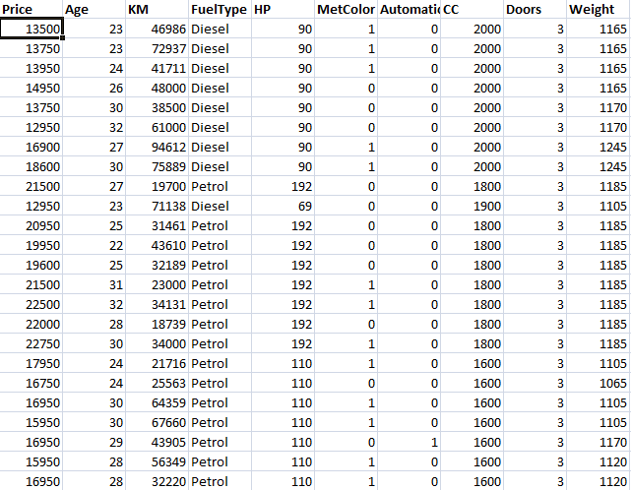
Step 1: Import the Dataset.
Script:-
dataset=read.csv("ToyotaCorolla.csv")

Slide 13
Step 2: Data Preprocessing
Qualitative Variable
There is no missing values in the dataset.
Change the Qualitative variable into factors.
Script:-
dataset$FuelType=factor(dataset$FuelType,levels=c("CNG","Diesel","Petrol"),labels=c(0,1,2))

Slide 14
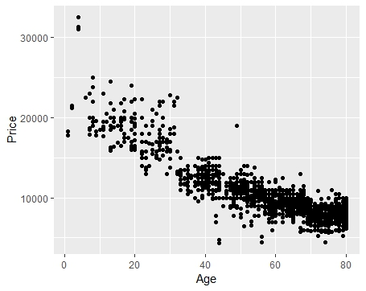
Step 3: Exploratory Data Analysis
Script:-
ggplot(dataset,aes(y=Price,x=Age))+geom_point()

Slide 15
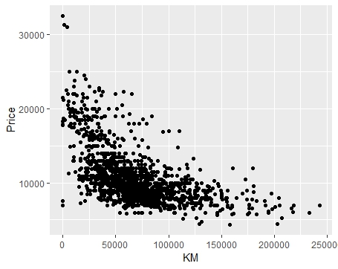
Script:-
ggplot(dataset,aes(y=Price,x=KM))+geom_point()

Slide 16
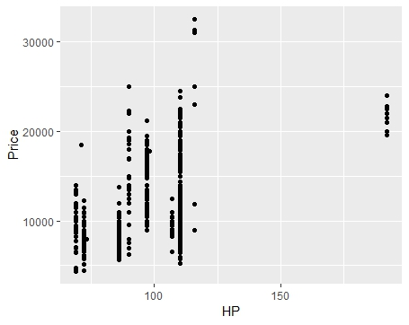
Script:-
ggplot(dataset,aes(y=Price,x=HP))+geom_point()

Slide 17
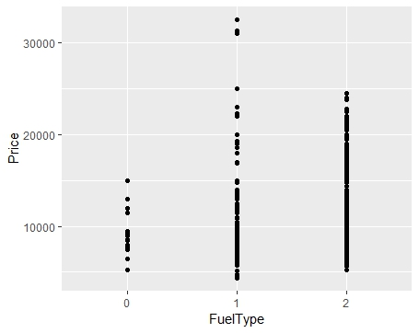
Script:-
dataset=read.csv("ToyotaCorolla.csv")

Slide 18
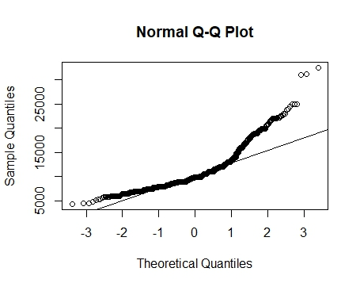
Script:-
qqnorm(dataset$Price)
qqline(dataset$Price)

Slide 19
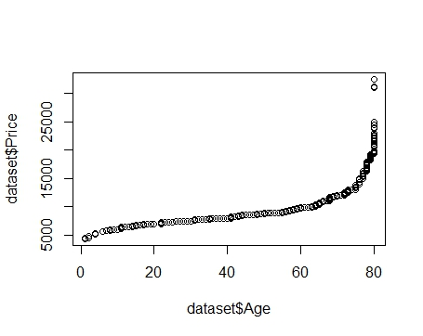
Script:-
qqplot(dataset$Age,dataset$Price)

Slide 20
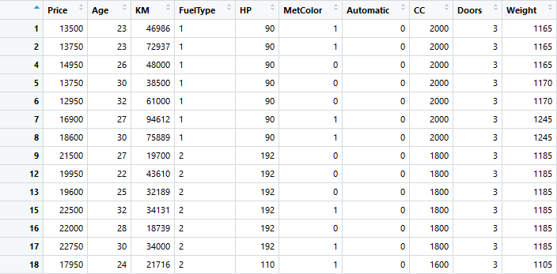
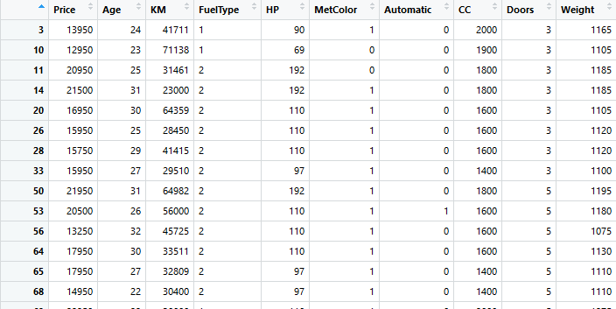
step 4: Divide the data into Training data and Test Data
Training Dataset
Script:-
split=sample.split(dataset$Price,SplitRatio = 0.8)
training_set=subset(dataset,split==TRUE)
test_set=subset(dataset,split==FALSE
Test Dataset

Slide 21
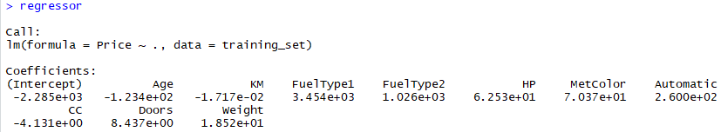
Step 5: Now apply the linear Regression model
Script:-
regressor=lm(formula = Price ~ .,data = training_set)

Slide 22
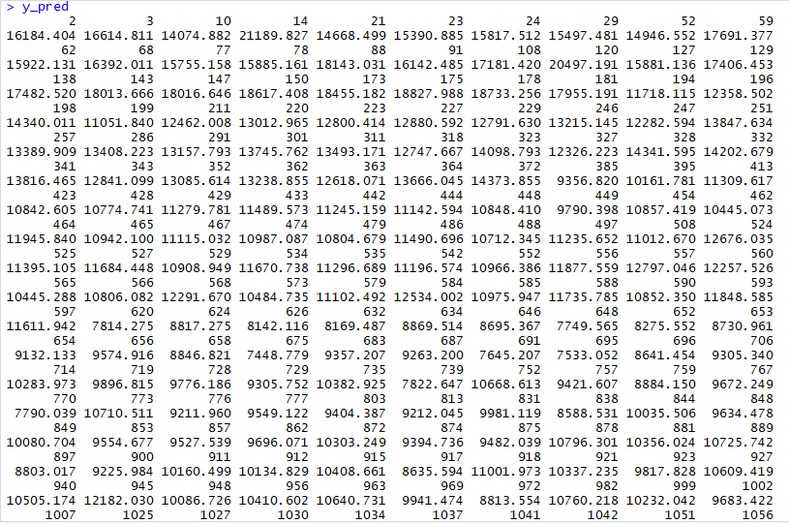
Step 6: Now apply the model on Test dataset
Script:-
y_pred=predict(regressor,newdata = test_set)

Slide 23
82.4 %
Step 7: Test the Accuracy of the model
Script:-
cor.test(y_pred,test_set$Price)

Slide 24
THANKS!
Any questions?

